Slide 1
Promoting inclusive growth in France:
The essence of Macron’s economic strategy

Slide 2
Secular stagnation?
Gordon and the fruit-bearing tree approach
Summers and the keynesian approach

Slide 3
Two productivity growth waves

Slide 4
Secular stagnation?
Dale Jorgenson
Missing Growth
Europe

Slide 5
Schumpeterian growth theory
Long-run growth driven by innovations
Innovations result from entrepreneurial activities motivated by prospect of innovation rents
Creative destruction: new innovations displace old technologies

Slide 6
Appropriate growth policies
During the post-war period, growth in European countries was driven by imitation
Over time, and particularly with globalization, innovation has become the driving force of growth
Innovation requires flexibility and turnover, and different policies and institutions

Slide 7
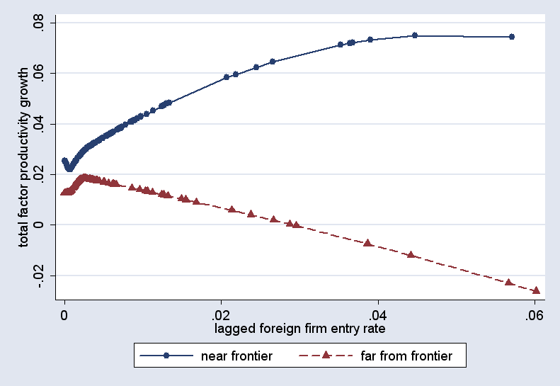

Slide 8
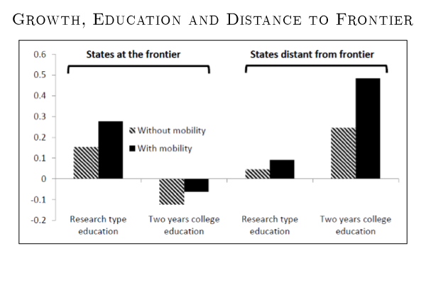

Slide 10
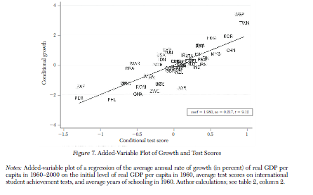
PISA and growth

Slide 12
Enhancing innovation-led growth in advanced countries
- Invest in knowledge economy (innovation)
- Invest in (higher) education
- Liberalize product and labor markets

Slide 13
Enhancing productivity growth in emerging market economies
Foster technology transfers
Reallocate factors
Improve management practices

Slide 14
Average management scores across countries are strongly correlated with GDP per capita
Data includes 2013 survey wave as of 9/20/2013. Africa data not yet included in the paper

Slide 15
Wide variation in management: US and Japan leading, developing nations trailing (includes 2013 wave)

Slide 17
Factor #3: Upward Mobility vs. Test Scores
55
50
45
Upward Mobility (Y₂₅ )
40
ρ = 0.589
(0.087)
35
30
40
50
60
70
Mean School Percentile Rank (Based on Grade 3-8 Reading and Math)

Slide 20
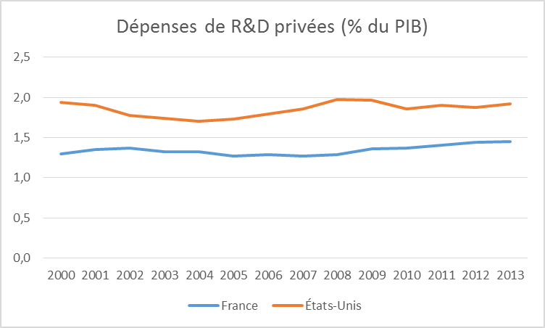

Slide 21
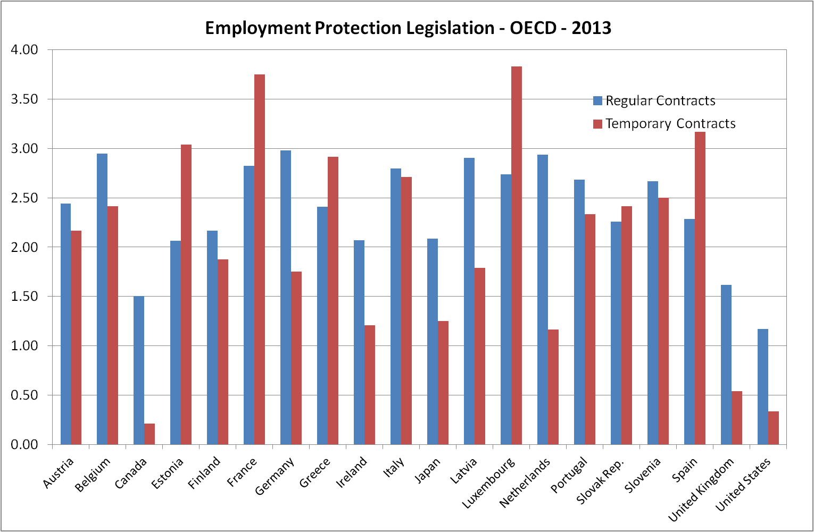
The French situation – Labor market regulation
21

Slide 22
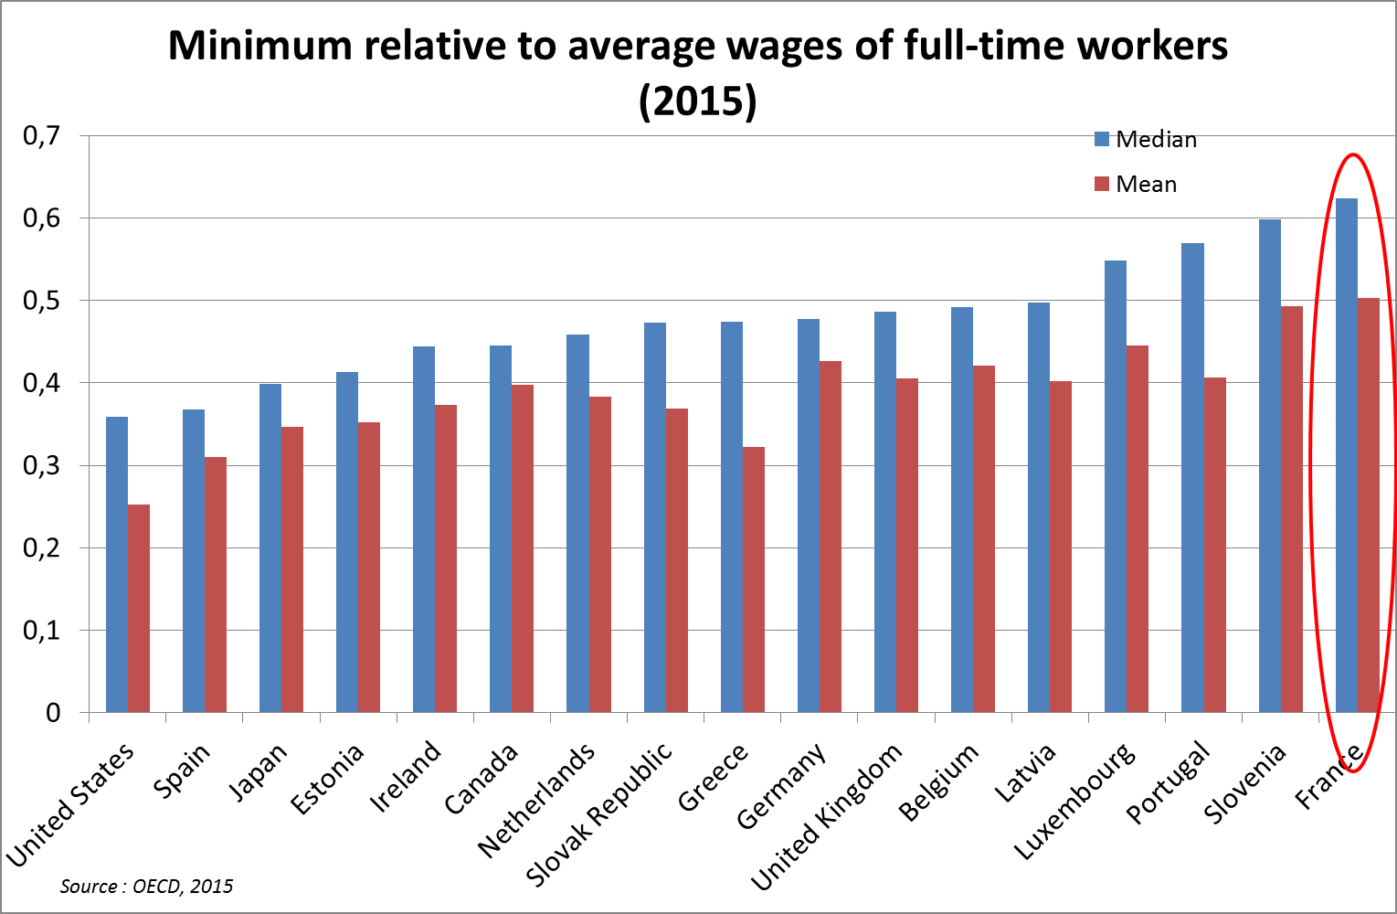
The French situation – Minimum wage
22

Slide 23
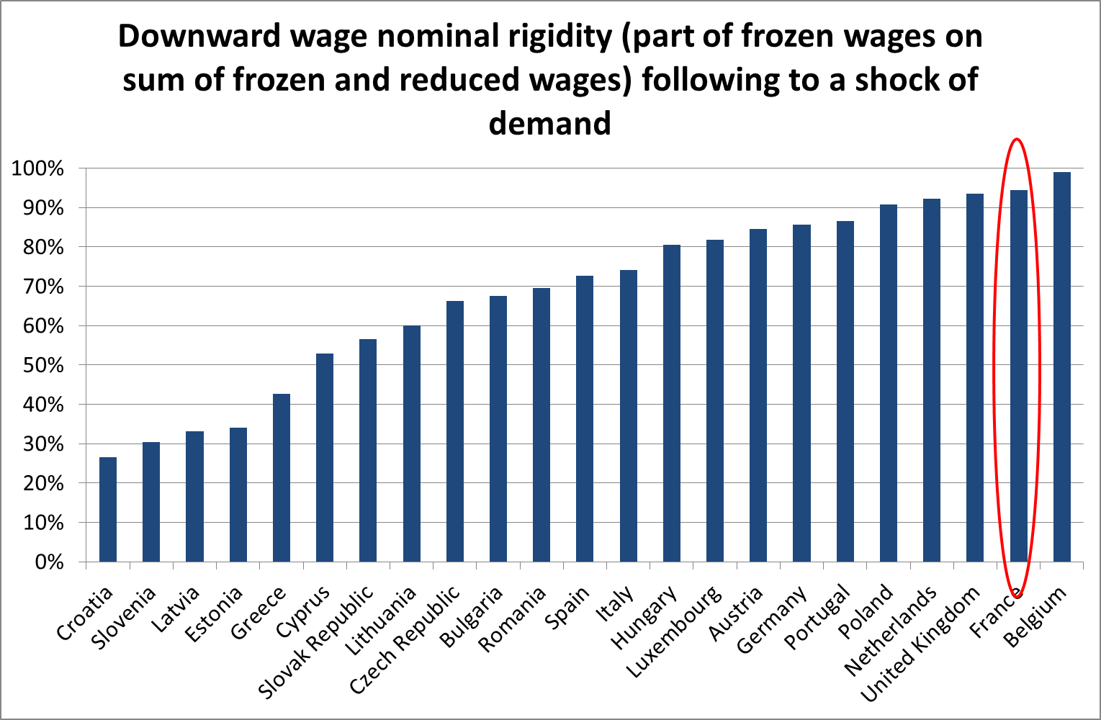
The French situation – Wage rigidities

Slide 24
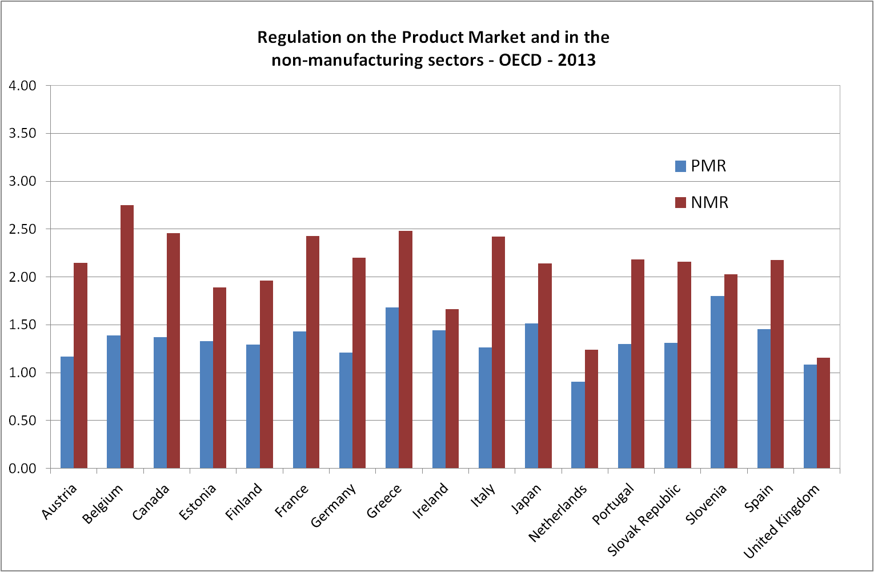
The French situation – Product market regulation
24

Slide 25
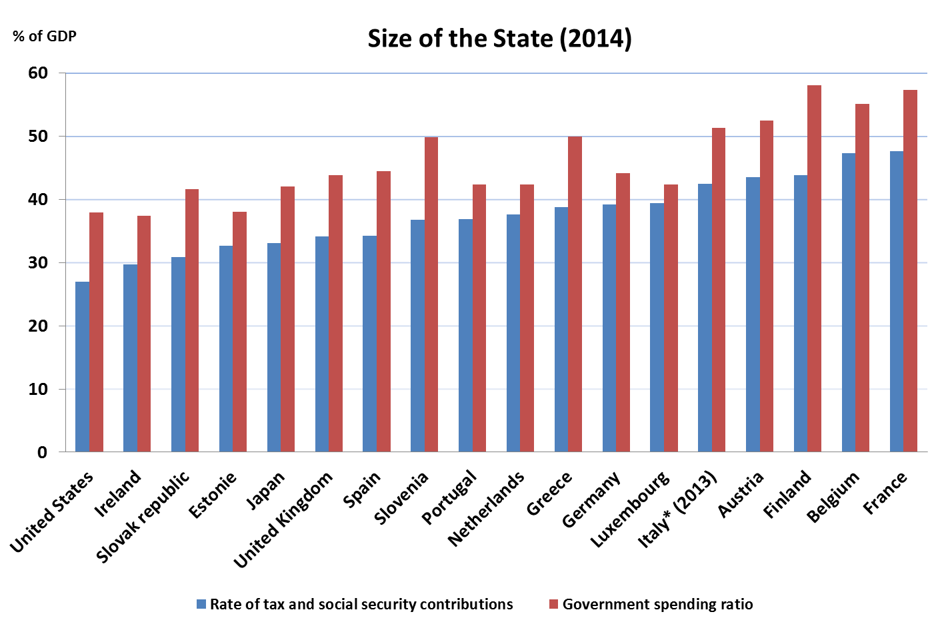
The French situation – State intervention
  Source: OECD
25

Slide 26
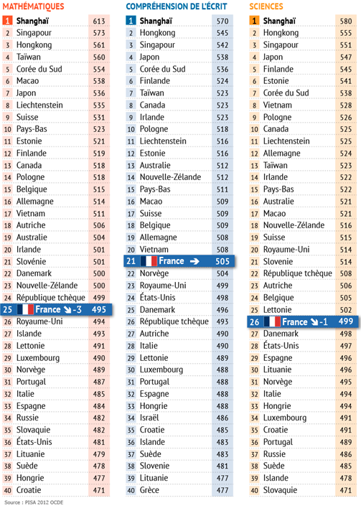
The French situation –
Education
From PISA - OECD
Performance in reading and science remains relatively constant between 2009 and 2012.
French PISA rank decreases from 22th to 25th in mathematics scale.

Slide 27
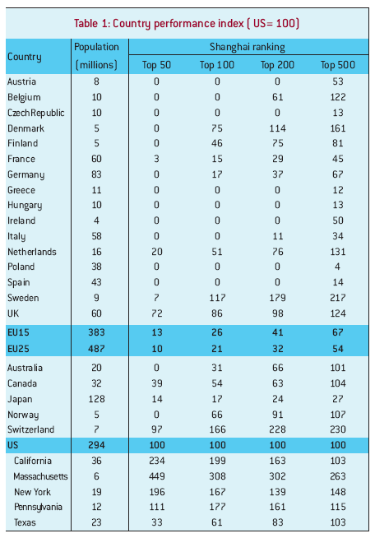
Notes:
27

Slide 28
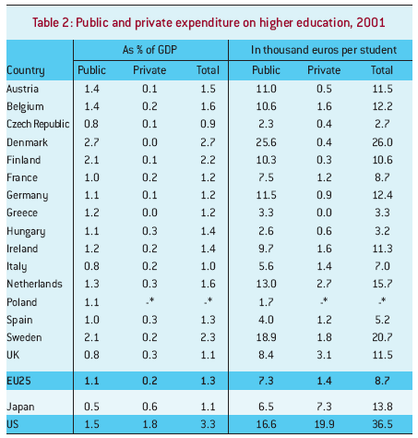
Notes:
28

Slide 29
Which potential gains from structural reforms?
    Long term productivity impact of structural reforms
29

Slide 30
Rethink tax reform
Design tax system which:
  Is simple
  Is redistributive and finances growth-enhancing public investments
  Does not deter innovation

Slide 31
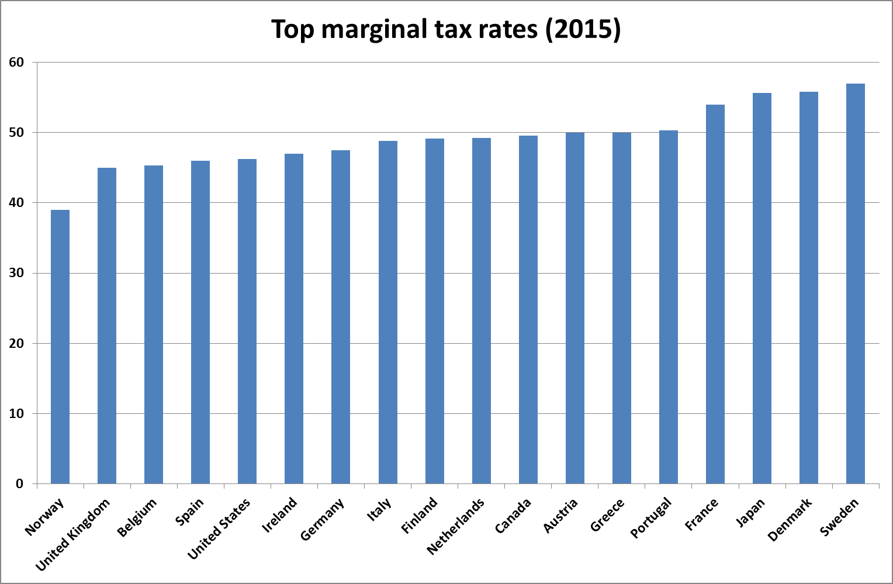
The French situation – Income tax rate
  Source: OECD

Slide 32
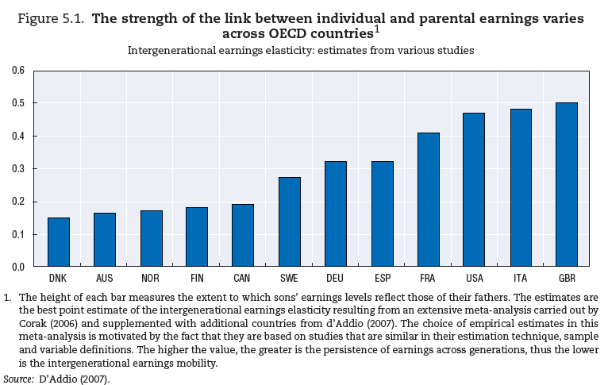
The French situation – Social mobility

Slide 33
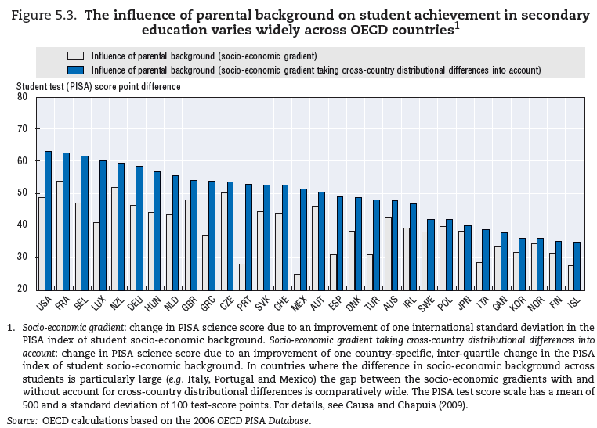
The French situation – Social mobility

Slide 34
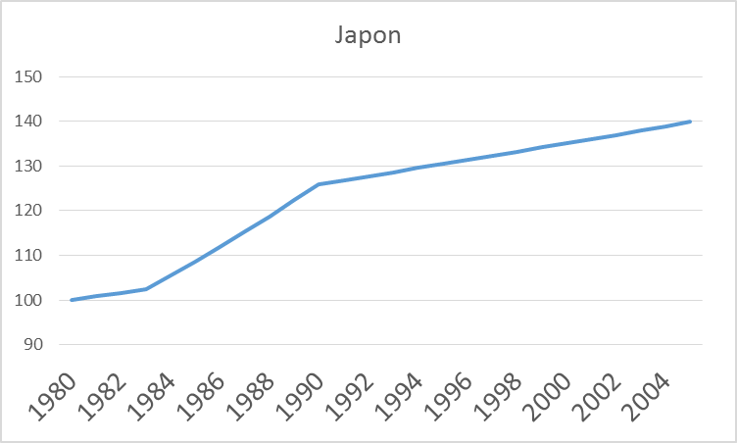
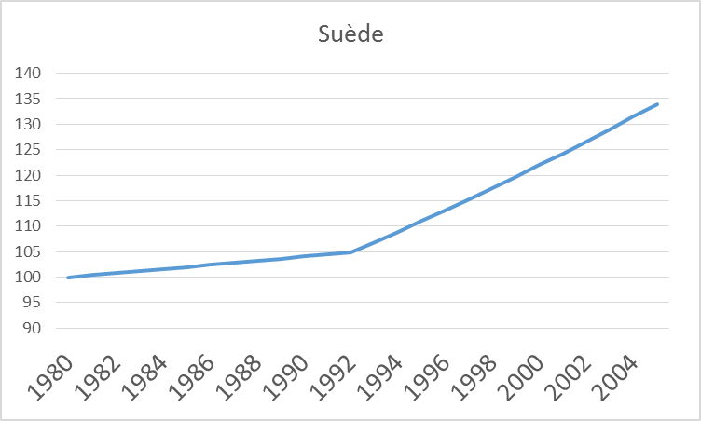
Productivity trends in Sweden and Japan

Slide 35
Reform pays out
Reformers
Netherlands: Wassenaard agreement, 1982
TFP growth : 1977-1983 0,5 %, 1983-2002 1,5 %
Canada: reforms initiated in early 1990s
TFP growth: 1974-1990 0,3 %, 1990-2000 1,1 %
Australia: reforms initiated in early 1990s
TFP growth: 1971-1990 0,4 %, 1990-2002 1,4 %
Sweden: reforms initiated in early 1990s
TFP growth: 1976-1992 0,4 %, 1992-2008 1,9 %

Slide 36
Macron’s reform strategy
Invest in innovation and liberalize product and labor markets
Make growth inclusive also by:
  Thinking about the losers
  Investing more and better in education
  Providing generous unemployment benefits conditional on retraining
  Set up an efficient tax system which finances public policies while not discouraging innovation

Slide 37
Pillars of Macron’s reforms
Tax reform
Labor market reform
Reform of the pension system
Reform of the State

